Slide 1
US vs. UK
STUDENT NEWSPAPER
Ashley + Ziyad

Slide 2
Table of contents
RQs
Content Difference
Importance
Stylistic Difference
Data
Limitation
Methodology
Future Improvement

Slide 3

Potential Research Questions
RQ1: Comparative Analysis of 2 Education Systems
How does a liberal arts education affect the writing practices of college newspaper journalists, compared to those who do not receive a liberal arts education?
RQ2: Convergence of writing style
Are there any noticeable convergences or divergences in the style or content of articles in the two countries?

Slide 4

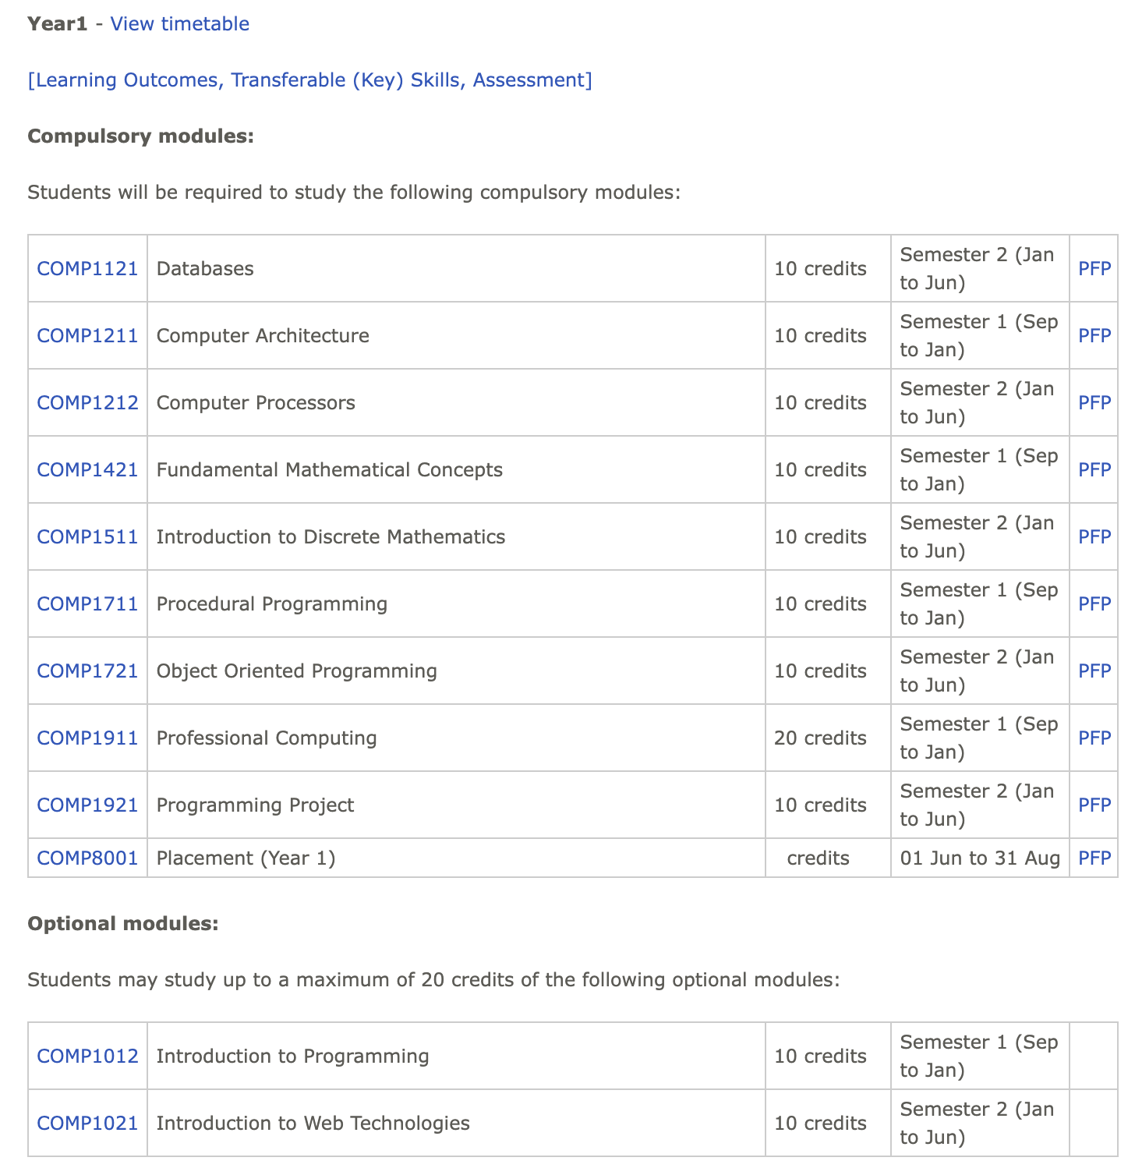
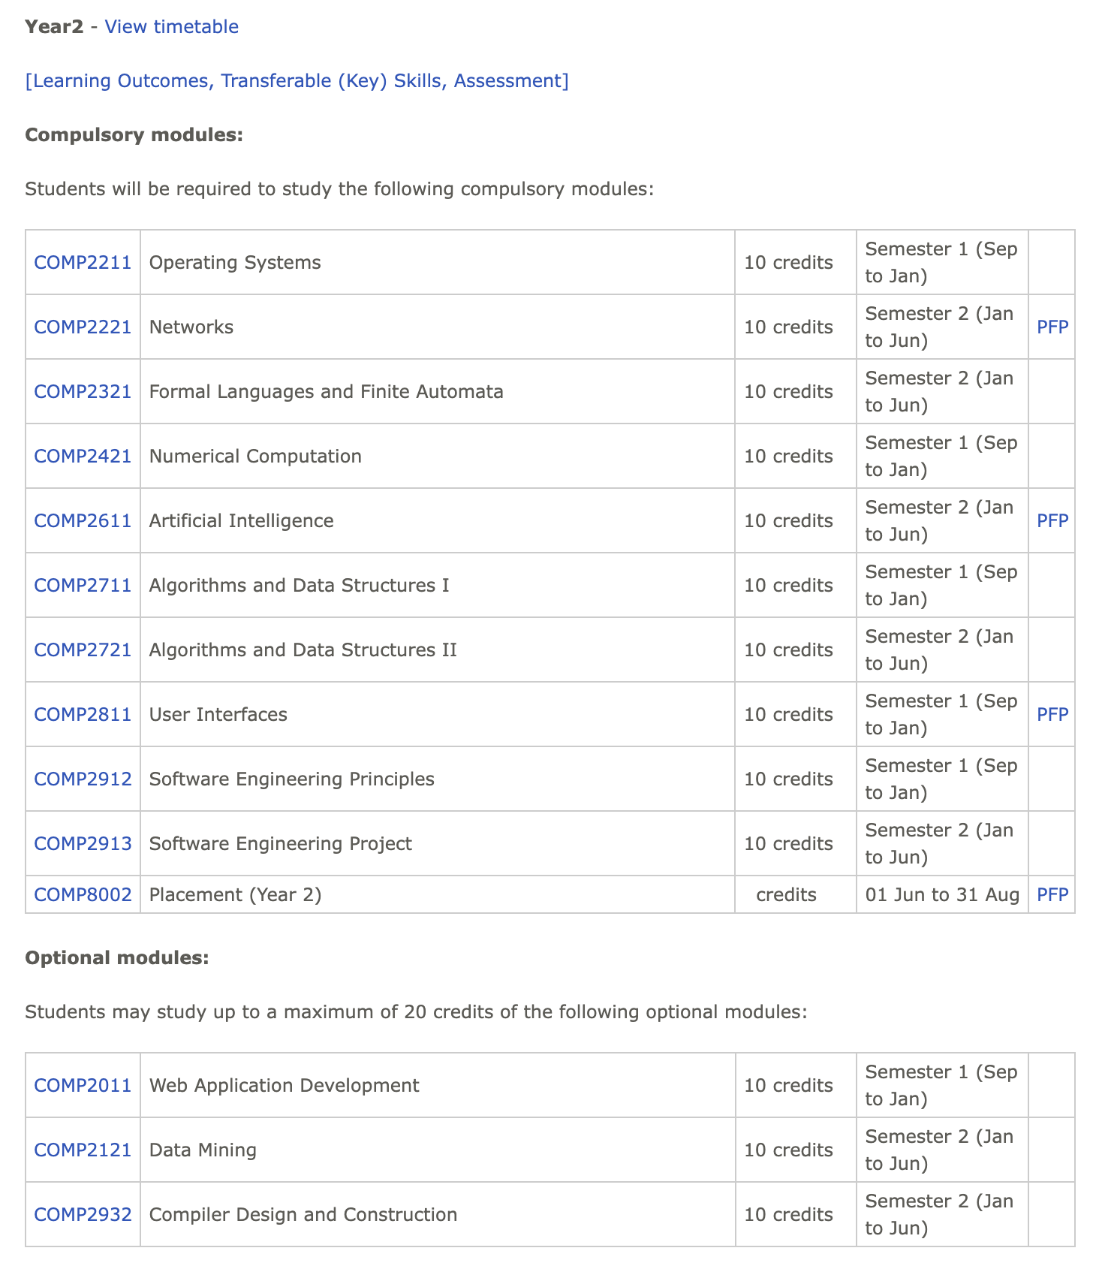
Importance
US Undergraduate Education System
UK Undergraduate Education System
Liberal Arts Education
a well-rounded foundation for future careers or graduate studies
Specialized University System
more focused and targeted towards specific career paths

Slide 5
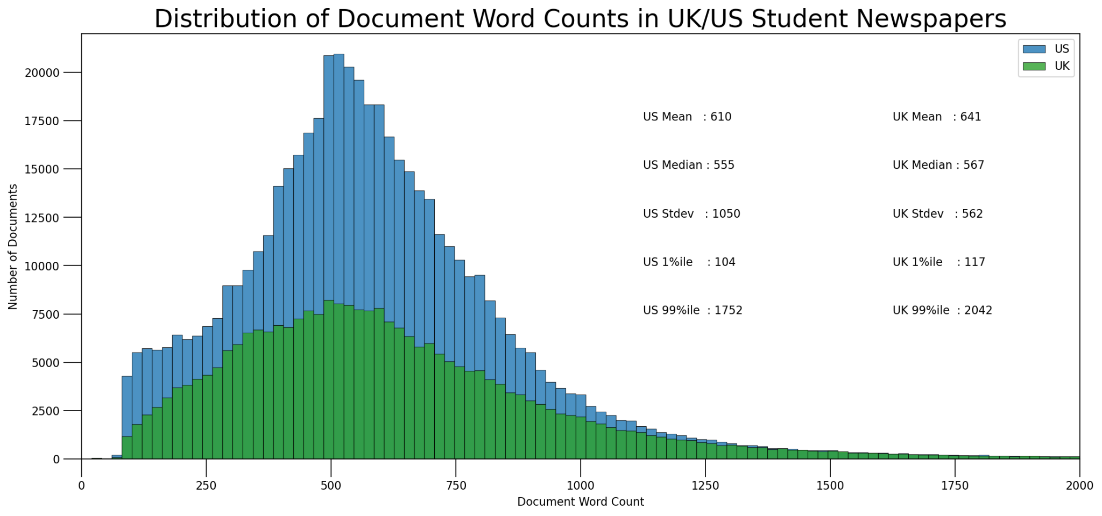
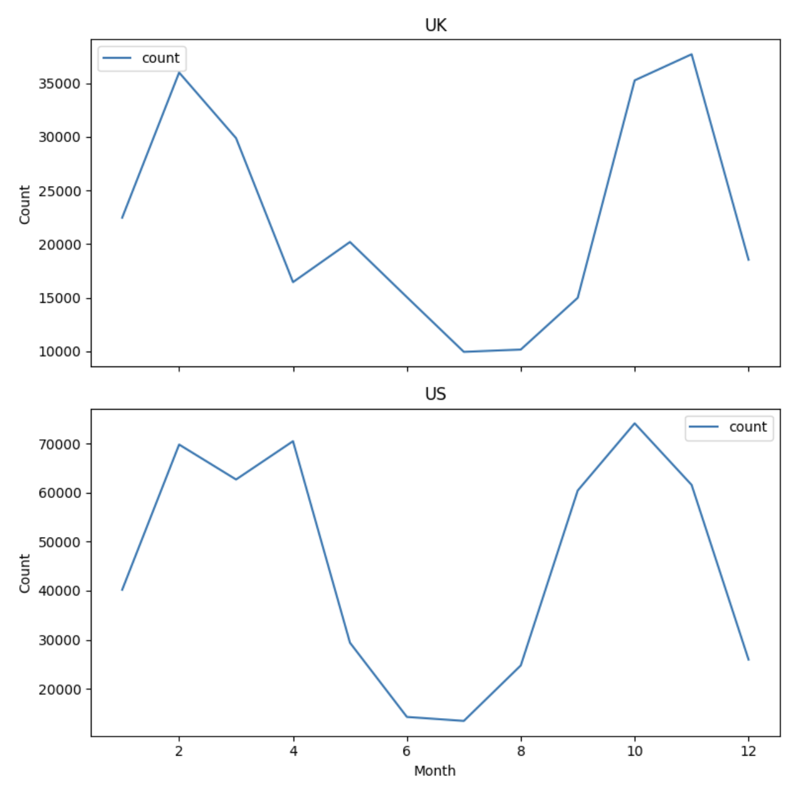
Data (1/3)
Data Collection
Scraped from a list of UK and US student newspapers on Wikipedia. Exhausting the list for the UK generates 50 feasible newspaper websites to scrape from and random sampling a set of 100 for the US and narrow down to 47 newspapers websites to scrape.
Scraping for all 97 websites from 30/03/2023 to 06/04/2023 and cleaning (such as rescraping some time out requests and some articles that lacked the metadata such as dates, authors, titles) from 07/04/2023 to 14/04/2023.
Summary Statistics
Figure 1. Number of articles by month
Figure 2. Distribution of document word counts
Data is cyclic by nature, peaked at the start of Fall and Spring semester
1 percentile documents have less than 100 words

Slide 6
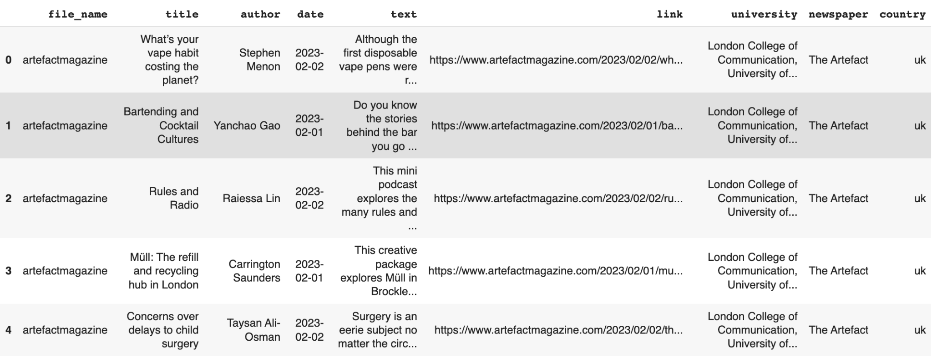
Data (2/3)
Summary Statistics: 817665 articles containing 490 million words
Figure 3. Table shows sample of dataframe

Slide 7
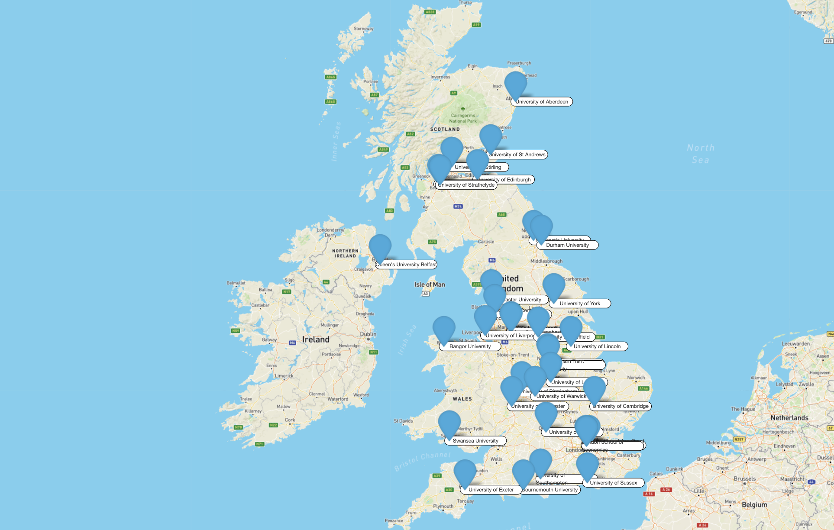
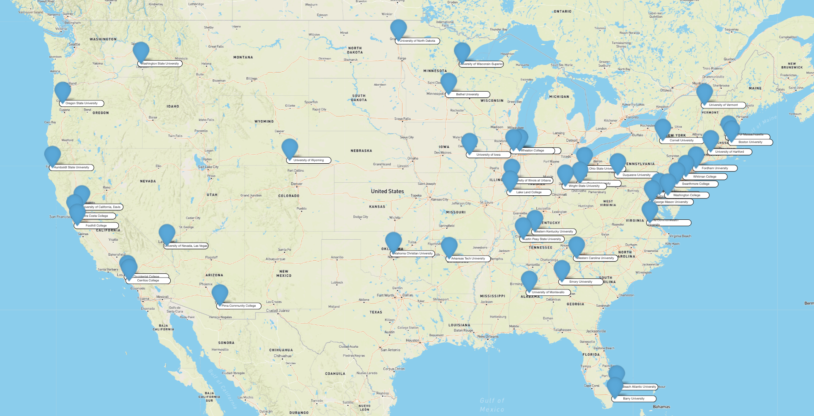
Data (3/3)
Summary Statistics
Figure 4. Universities student newspaper scraped in the UK
Figure 5. Universities student newspaper scraped in the US

Slide 8
List of US universities newspapers
university | newspaper
University of California, Davis | The California Aggie
Wright State University | The Guardian
University of Maryland, Baltimore County | The Retriever Weekly
Capital University | The Chimes
University of Montevallo | The Alabamian
Western Carolina University | Western Carolinian
Washington College | The Elm
Oklahoma Christian University | The Talon
Humboldt State University | The Lumberjack
Virginia Commonwealth University | The Commonwealth Times
University of Wyoming | The Branding Iron
University of Hartford | The Informer
Lake Land College | The Navigator News
University of Massachusetts Lowell | The Connector
Occidental College | The Occidental
Boston University | Daily Free Press
University of Wisconsin-Superior | The Promethean
Barry University | The Buccaneer
Cornell University | The Cornell Daily Sun
Troy University | Tropolitan
Contra Costa College | The Advocate
Bethel University | The Clarion
Washington State University | The Daily Evergreen
Pima Community College | The Pima Post
university | newspaper
Palm Beach Atlantic University | The Beacon Today
University of Iowa | The Daily Iowan
Duquesne University | The Duquesne Duke
Illinois Wesleyan University | The Argus
Western Kentucky University | College Heights Herald
Wheaton College | Wheaton Wire
Cerritos College | Talon Marks
DePaul University | The DePaulia
Columbia College | Columbia Chronicle
Oregon State University | The Daily Barometer
Fordham University | The Fordham Ram
Fordham University | The Observer
Ohio State University | The Lantern
University of Nevada, Las Vegas | Scarlet & Gray Free Press
Austin Peay State University | The All State
Emory University | The Emory Wheel
Whitman College | The Pioneer
Swarthmore College | The Phoenix
Arkansas Tech University | Arka Tech
Foothill College | The Sentinel
University of Vermont | The Vermont Cynic
University of North Dakota | Dakota Student
Figure 6. List of US universities students newspapers scraped

Slide 9
List of UK universities newspapers
university | newspaper
None | The National Student
None | The Student Pocket Guide
University of Birmingham | Redbrick
Bournemouth University | The BUzz
University of Brighton - The Verse | The Verse
British and Irish Modern Music Institute | LDN Music Magazine (London)
University of Cambridge | Varsity
University of Central Lancashire | The Pulse
Durham University | Palatinate
Durham University | The Bubble
University of East Anglia | Concrete
University of Exeter | Exeposé
Falmouth University & University of Exeter | The Falmouth Anchor
Lancaster University | SCAN
University of Leeds | Leeds Student
University of Leicester | Leicester Student Magazine
University of Lincoln | The Linc
University of Liverpool | The Sphinx
University of the Arts London | The Artefact
King's College London | Roar News
London School of Economics | The Beaver
Royal Holloway, University of London | The Orbital (official)
university | newspaper
Royal Holloway, University of London | The Founder (unofficial)
School of Oriental and African Studies | The SOAS Spirit
Queen Mary, University of London | The Print
Manchester Metropolitan University | aah-magazine
University of Manchester | The Mancunion (official)
Newcastle University | The Courier
University of Nottingham | Impact
Nottingham Trent University | Platform Magazine
University of Oxford | The Oxford Blue
University of Oxford | The Oxford Student
University of Oxford | Cherwell
University of Oxford | The Isis
University of Sheffield | Forge Press
University of Southampton | Wessex Scene
University of Southampton | The Edge (magazine)
University of Sussex | The Badger
University of Warwick | The Boar
University of Worcester | The Voice
University of York | York Vision
Queen's University Belfast | The Gown
Figure 7. List of UK universities students newspapers scraped

Slide 10
Methodology
Preliminary Analysis
Stage 1
Stage 2
Content Difference
Stylistic Difference
Combine Result
Topic Modelling
LDA
LIWC
Branching Factor
Validation for both stages: Manually read random sample documents from all topics and top and bottom LIWC scores

Slide 11
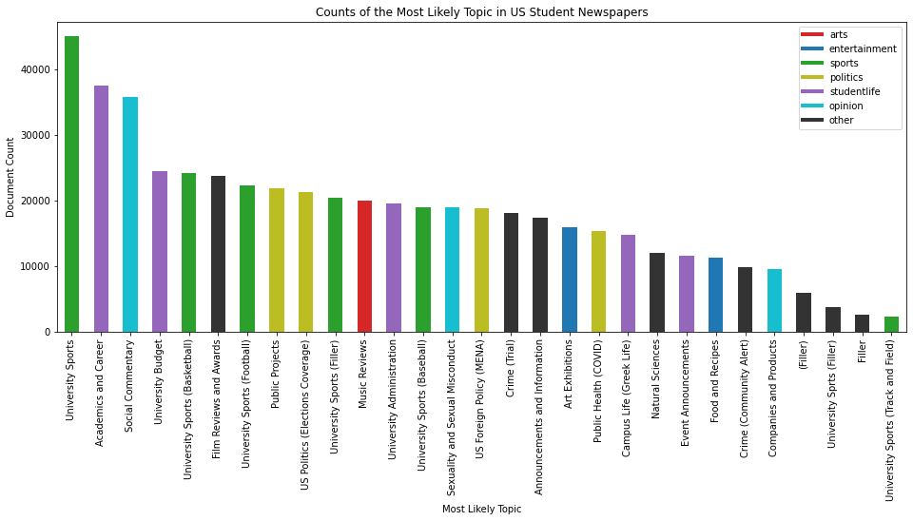
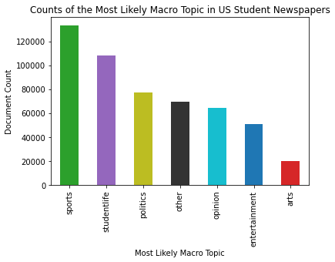
Content Difference (1/4)
US Topic Prevalence

Slide 12
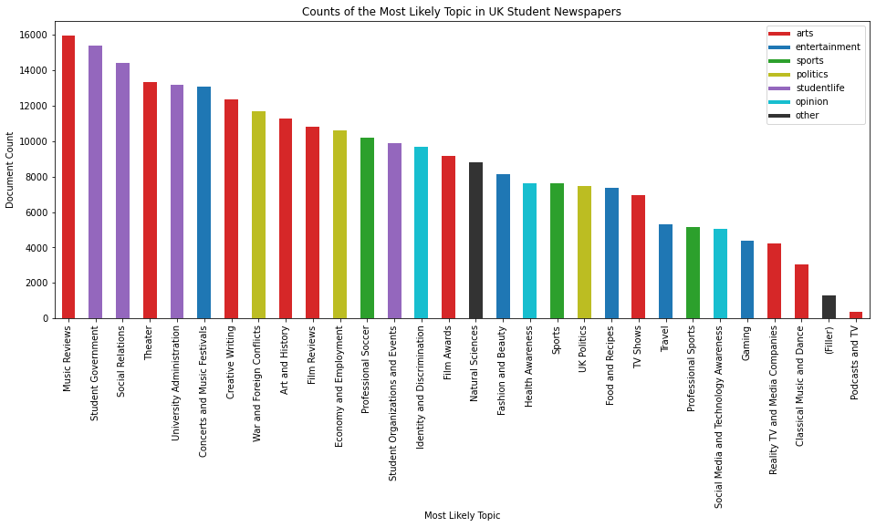
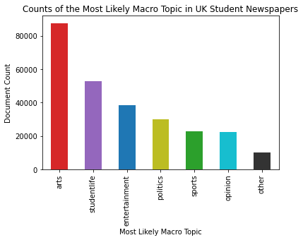
Content Difference (2/4)
UK Topic Prevalence

Slide 13
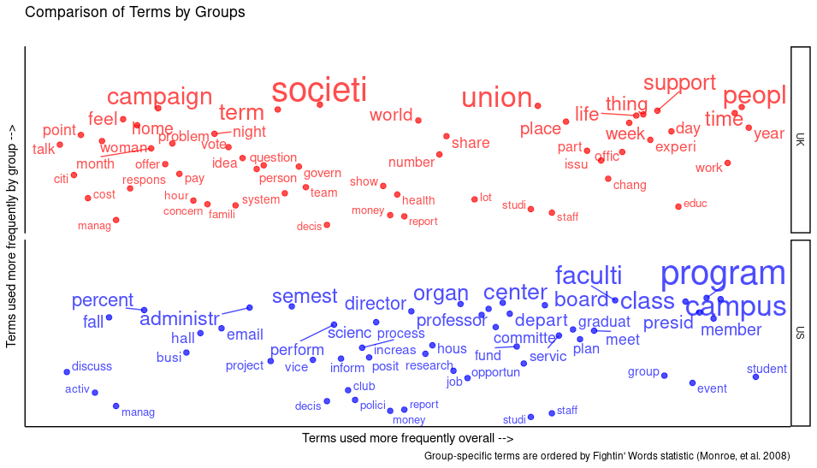
Content Difference (3/4)
Fightin’ Words (Student Life)
UK
Greater focus on student government [campaign, vote] and issues relating to social life and relations [life, famili, feel]
US
Greater focus on academics, career [class, job, opportun], and the university administration [faculti, professor, depart]

Slide 14
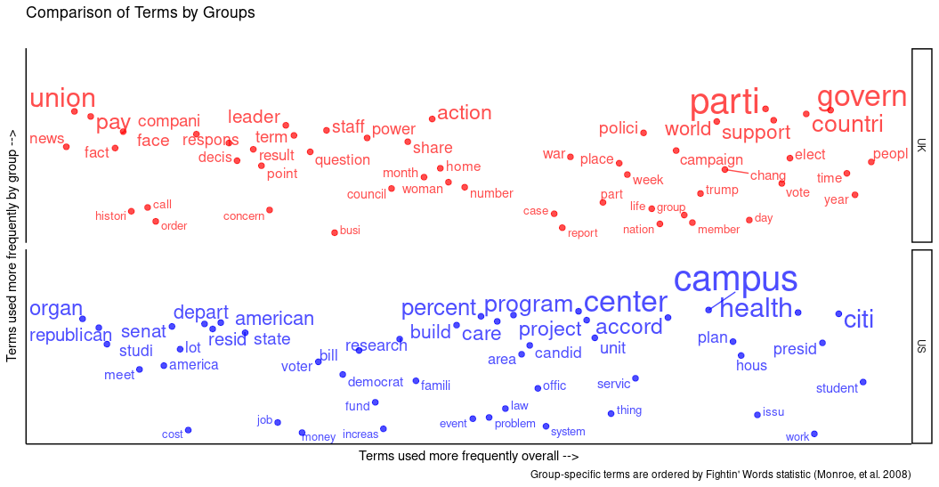
Content Difference (4/4)
Fightin’ Words (Politics)
UK
Greater focus on war and foreign conflicts (less focused on the UK's part in the conflict) [war], and economy and employment [union, pay, compani]
US
Greater focus on public (city) projects [build, project], elections, foreign policy (talk about foreign events but usually links back to US figures and policies), and public health [health]

Slide 15
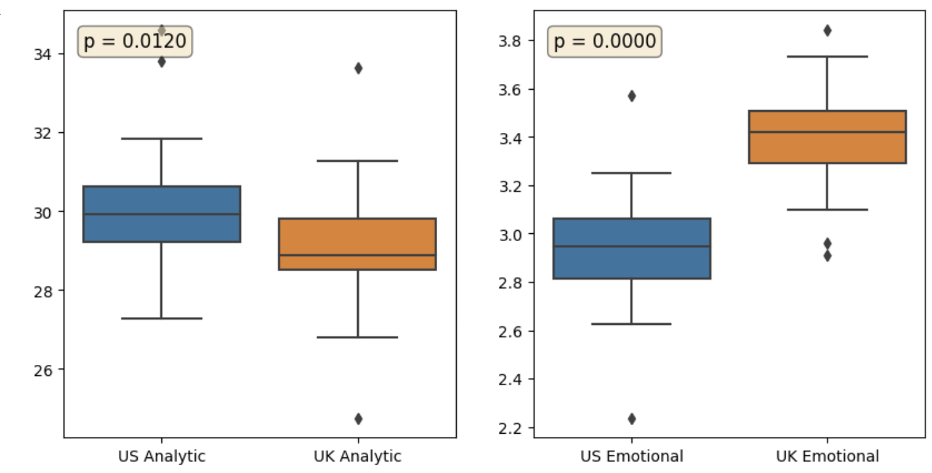
Stylistic Difference (1/3)
LIWC Score: Analytical Thinking & Emotional Tone
Analytical Thinking: Degree of use of categorical vs dynamic language.
Higher grades ~ greater article and preposition use
(i.e., references to complexly organized objects and concepts).
Lower grades ~ greater use of auxiliary verbs, pronouns, adverbs, conjunctions, and negations, indicating more dynamic language (i.e., personal narratives).
=> Cognitive styles rewarded by higher education institutions (Pennebaker, 2014).
Analytic = 30 + article + preposition - personal pronoun - impersonal pronoun – auxiliary verb – conjunction – adverb – negation
Emotional Tone = positive emotions + negative emotions
Emotional Tone:
Positive emotion: love, nice, sweet
Negative emotion hurt, ugly, nasty (Pennebaker, 2015)
Figure 8. Analytic & Emotional Tone score comparison

Slide 16
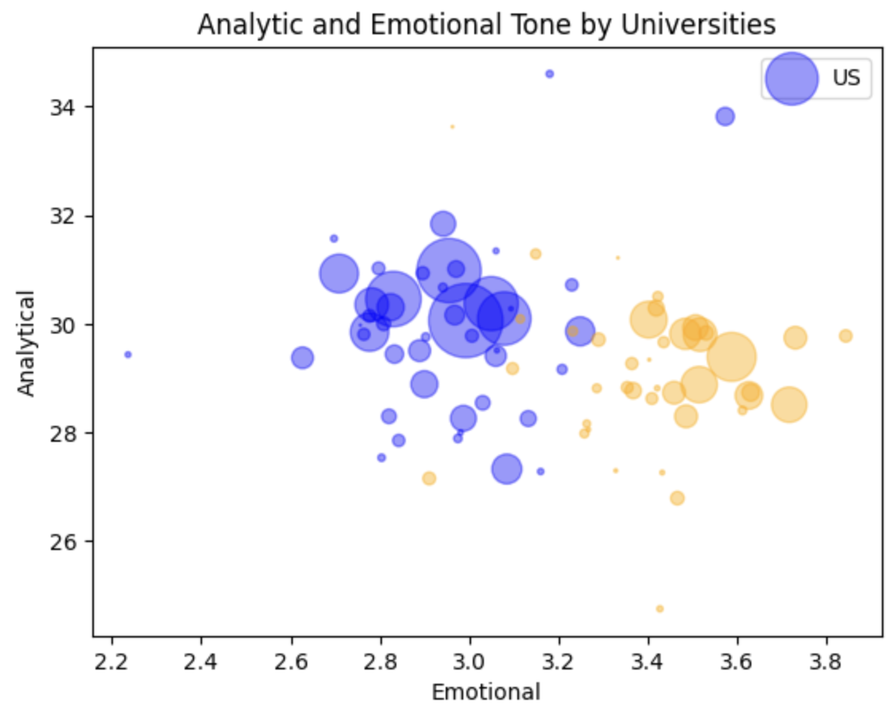
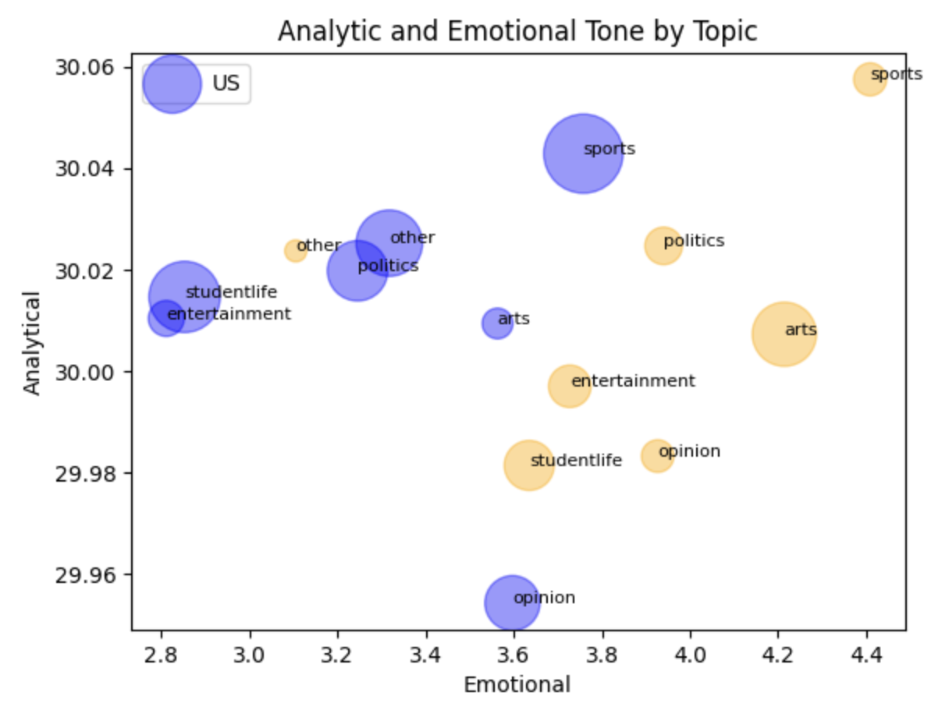
Stylistic Difference (2/3)
LIWC Score
Figure 9. Analytic & Emotional Tone by Universities
Figure 10. Analytic & Emotional Tone by high-level topic

Slide 17
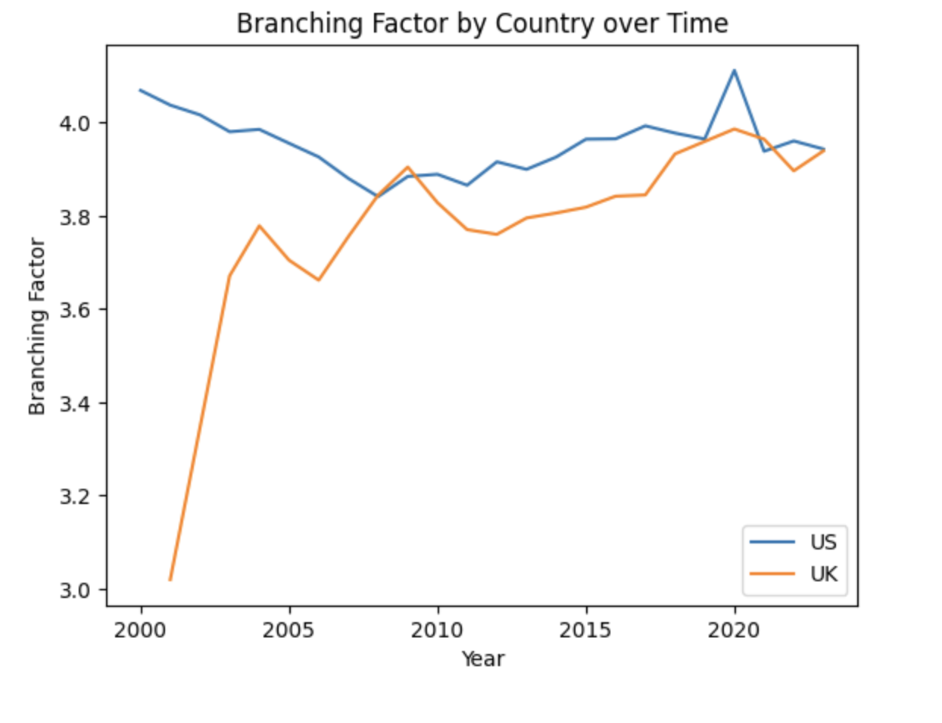
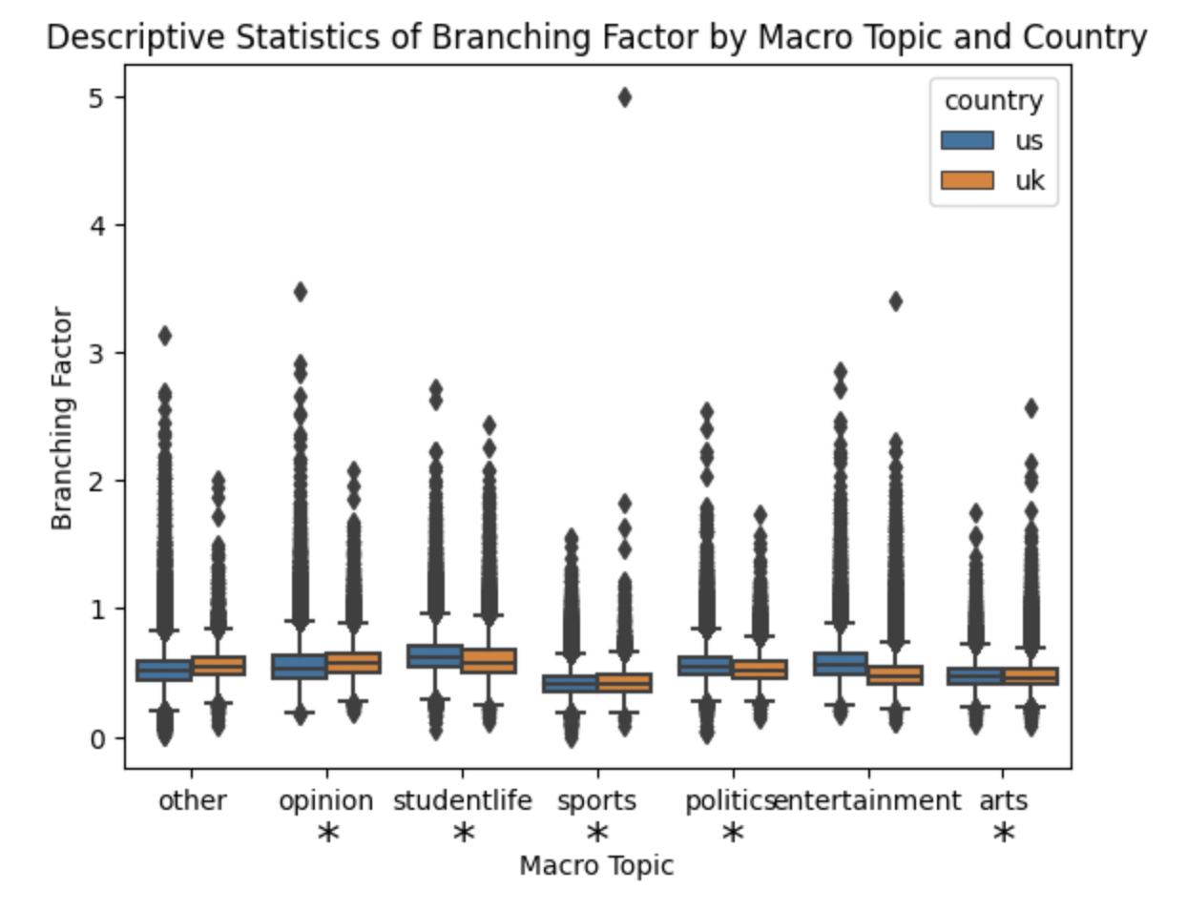
Stylistic Difference (3/3)
Readability
There is an increasing trend of concreteness for both US and UK student newspapers over time and the concreteness of articles converge.
Student Life, Opinion, Sports, Politics, and Arts articles have statistical significance in their concreteness score between 2 corpuses.

Slide 18
Conclusion
RQ1: Comparative Analysis of 2 Education Systems
Students with liberal arts education tend to use fewer pronouns and distance themselves more from the writing topic in general and across comparable topics.
US student newspapers have higher proportion of articles related to student life such as academic, campus sports, and career, while UK student newspapers report more on entertainment or use newspapers as platform for their campaign in student government.
RQ2: Convergence of writing in longitudinal data
Over time, the concreteness of the articles converge between students with and without liberal arts education.

Slide 19
Limitation
` L1: British English vs. American English
The vocabulary and linguistic styles used in British and American newspapers might differ because of the linguistic differences in British and American English. Some degree in the differences observed might be due to the version of English used in the newspaper.
L2: Noise from scraping
Some of the documents generated during the web scraping process might have caught some HTML noise and might have been written in a language different than English. However, those documents were generally easily observed during the topic modeling process.

Slide 20
Future Improvement
I1: Validation through random US and UK newspapers
Random sample of articles from different newspapers from the US and UK or just from NY Times and BBC to see whether British English and American English affect LIWC score significantly.
I2: Surveys with university student newspaper editors
We can contact a number of editors from the list of newspaper that we scrape to understand how they select their published articles to draw some differences.
I3: Clustering algorithms for higher-level topic
Because of time constraints, we map the topic to higher-level topic through manual selection. However, an unsupervised community detection algorithm will generate more systematic results.

Slide 21
References
Pennebaker, J. W., Chung, C. K., Frazee, J., Lavergne, G. M., & Beaver, D. I. (2014). When small words foretell academic success: The case of college admissions essays. PLOS ONE, 9(12), e115844. https://doi.org/10.1371/journal.pone.0115844
Pennebaker, J. W., Boyd, R. L., Jordan, K., & Blackburn, K. (2015). The Development and Psychometric Properties of LIWC2015. University of Texas at Austin, Austin, TX.
Douglas Guilbeault, Ethan O. Nadler, Mark Chu, Donald Ruggiero Lo Sardo, Aabir Abubaker Kar, Bhargav Srinivasa Desikan. Color associations in abstract semantic domains. Cognition, Volume 201, 2020, 104306, ISSN 0010-0277. https://doi.org/10.1016/j.cognition.2020.104306.
Monroe, B., Colaresi, M., & Quinn, K. (2017). Fightin' Words: Lexical Feature Selection and Evaluation for Identifying the Content of Political Conflict. Political Analysis, 16(4), 372-403. doi:10.1093/pan/mpn018
Blei, David M., Andrew Y. Ng, and Michael I. Jordan. "Latent dirichlet allocation." Journal of machine Learning research 3.Jan (2003): 993-1022.

Slide 22
THANKS

